Slide 1
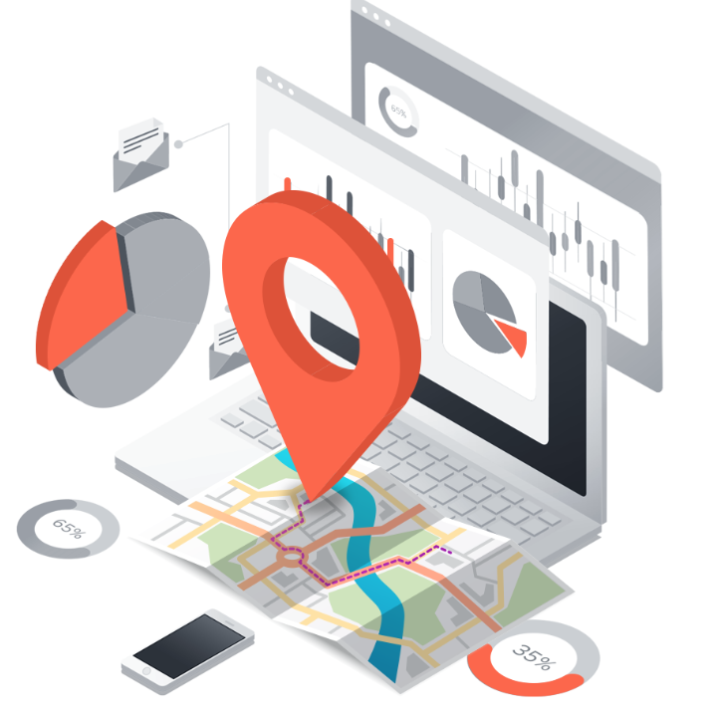
Local seo
Sahar andaleeb
Week # 09
Local SEO
By: Sahar Andaleeb

Slide 2
What is local seo?
“Local SEO is the practice of optimizing a business’s visibility in local search results.”
SEO vs Local SEO:
SEO involves enhancing a website to attain better positions in search engine results pages (SERPs) for particular keywords or phrases.
targets a global or national audience and aims to attract users from all over the world or a larger region.
Local SEO, on the other hand, is a process to improve search rankings for local search queries specific to a particular geographic area or region.

Slide 3
Why is Local SEO Important?
If your business isn't optimized for local search, you could miss out on potential customers ready to shop in your area.
Majority of consumers in several countries rely on Google for local business information.
Searches like "shopping near me" on Google Maps have surged by over 100% annually, while mobile queries for "store open near me" have also increased by over 200% in recent years.
Using local SEO can access this vast daily search volume, leading to increased traffic and customers for your site.

Slide 4
How does Local SEO Work?
Google’s local search algorithms use three main factors to help find the best match:
Relevance (how closely related a Google Business Profile result is to the words a searcher uses in their query)
Distance (how far Google believes a user is from a business when they search)
Prominence (how important Google thinks a business is to its potential customers)

Slide 5
… cont.
Then, Google displays two types of search results for local searches.
The local pack results and organic results.
A local pack” (Google Maps and Business Profiles) is a Google feature that shows the top local business listings and a map.
Organic results are the “normal” blue link search results we’re all used to seeing on Google.

Slide 6
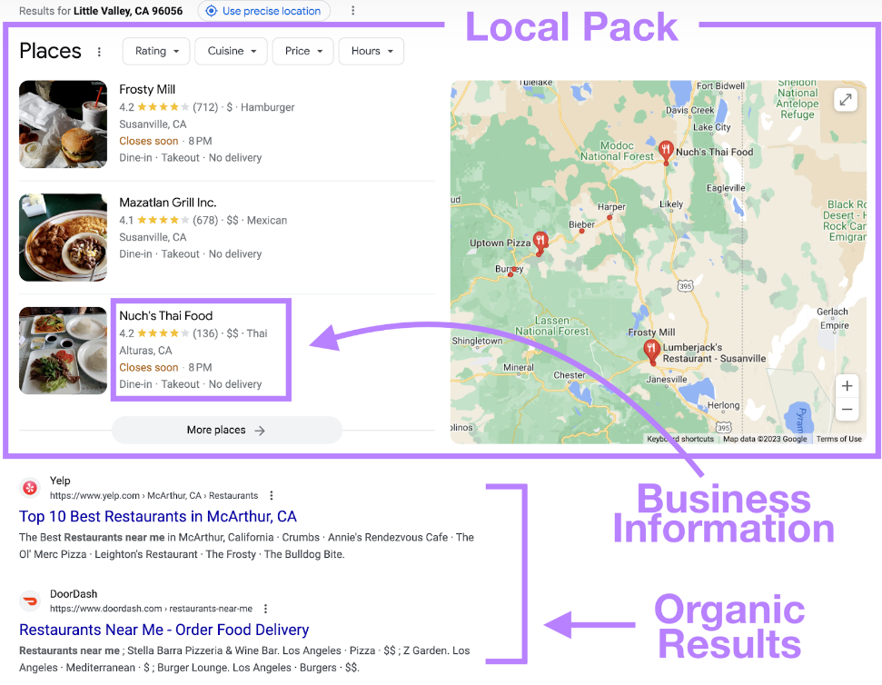
… cont.

Slide 7
…cont.
Does Google dispay local results only for queries containing local keywords?
No, Google doesn’t display local results only for queries that contain a city, state, or “near me” keyword. It all depends on the intent of the query.
If Google believes the intent of your search is local, it’ll display local results. Even if your search isn’t explicitly local.
For example, if you are in Islamabad and search for “barber shops,” Google would still display a local pack for Islamabad barber shops.

Slide 8
Ranking signals for local SEO
Google uses a different set of ranking factors to rank the local search results, including:
The location that the person is searching from
NAP citations
Presence of Google Business Profile listing
Keywords used in Google Business Profile
Sentiment of online reviews
Keywords used in online reviews
Number of “check-ins” at that location
Shares on social media
Google Maps star rating for that business

Slide 9
How to Do Local SEO?
Create a strategy to increase your local rankings and boost traffic.
Local SEO tips:
Local Keywords: Research and use relevant local keywords in your website content, meta tags, and headings.
Google My Business: Claim and optimize your Google My Business listing with accurate information, categories, and photos.
Local Citations: Get listed on local directories, review sites, and online listings with consistent NAP (Name, Address, Phone Number) information.
On-Page Optimization: Optimize your website's title tags, meta descriptions, and content for local relevance.
Mobile Optimization: Ensure your website is mobile-friendly for users searching on smartphones.

Slide 10
Reviews and Ratings: Encourage satisfied customers to leave positive reviews on Google and other review platforms.
Local Link Building: Build relationships with local businesses and organizations for relevant backlinks.
Social Media Back Linking: Engage with your local community on social media platforms, sharing updates and promotions.
Monitor and Analyze: Track your local SEO efforts using tools like Google Analytics and Google Search Console, adjusting strategies as needed.

Slide 11
1. Do Local Keyword Research
Location-Specific Keywords: Identify keywords that include your city, neighborhood, or region.
optimize for “store + city” keywords
Google Autocomplete: Use Google's autocomplete feature to find local keyword suggestions based on searches related to your business.
It can also help you discover valuable long-tail keywords for local SEO.

Slide 12
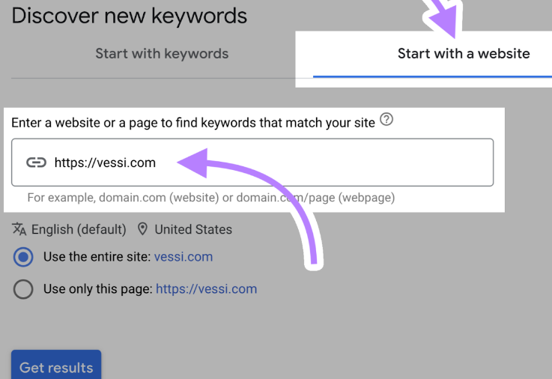
… cont.
Competitor Analysis: Look at your competitors' websites and see which keywords they are targeting for local search.
Leverage Google Keyword Planner for discovering local keywords to rank on:
“Discover new keywords” → “Start with a website” → “Get results”.

Slide 13
… cont.
Long-Tail Keywords: Consider longer, more specific phrases that reflect local intent and target niche markets.
User Intent: Understand the intent behind local searches (e.g., informational, navigational, transactional) to tailor your keyword strategy accordingly.

Slide 14
2. Optimize Your Google Business Profile
A Google Business Profile (formerly Google My Business) is a free business listing with information about your business.
It allows you to provide details like your location, services, products, and photos.
Business Profile tips:
Set detailed business hours (including holidays)
Select various attributes to describe your business (like outdoor seating, Wi-Fi, etc.)
Upload photos and videos regularly (promotes engagement and boosts rankings)

Slide 15
…cont.
To ensure you're optimized for Google My Business
Create and verify a Google My Business page.
Encourage your customers to share reviews online.
Respond authentically to reviews, specifying location.
For example, “We appreciate your feedback on [product/service] in [city, state]. We value your input and look forward to working with you again. Thank you from the [full company name] team.”

Slide 16
3. Get Local (NAP) Citations
NAP citations are places that mention your Name, Address, and Phone number online.
Usually appear on business directories and social media profiles.
NAP citations are important because Google may use them to verify that your business information is accurate.

Slide 17
NAP citation tips:
Submit your business to online directories.
How?
Identify major directories relevant to your business.
Visit each directory's website.
Look for options like "Add Your Business" or "Claim Your Business."
Provide accurate information and verify ownership if required.
Ensure 100% consistency in your business name, address, and phone number (NAP) across all listings.
On your website, on your Google Business Profile, on business directories, on local listings sites.

Slide 18
… cont.
Get listed on industry-specific directories and niche platforms relevant to your business.
Foodpanda, Zameen.com, PakistanLawyer.com, ServiceFinder.pk, PakPlumbers, Sehat.com.pk, workchest.com
Earn mentions and citations from local news websites, blogs, and community organizations by participating in events or sponsoring local initiatives.
Monitor and manage your citations regularly to update any changes in your business information.
Pro Tip: Avoid including NAP in the image. Images are not crawlable.

Slide 19
4. On-Page Optimization for local seo
Use location-specific keywords in title tags, meta descriptions, headings, and content.
Include your NAP (Name, Address, Phone number) in a visible location on each page.
Create location-specific landing pages if you have multiple locations.
Optimize your Google My Business listing with accurate information, photos, and reviews.
Use local schema markup to help search engines understand your business location.
Optimize images with alt tags containing local keywords and location information.

Slide 20
… cont.
Include local landmarks, neighborhoods, and events in your content where relevant.
Example:
Let's say you own a hotel in Islamabad, Pakistan.
mention nearby landmarks like Faisal Mosque, Daman-e-Koh, or Shakarparian Park in your website content.
If there's an upcoming event like the Islamabad Literature Festival or Islamabad Fashion Week, you could feature it in your content to attract visitors who may be attending or interested in those events.
This local context helps search engines understand your relevance to Islamabad and can boost your visibility in local search results.

Slide 21
5. Mobile Optimization for local seo
Responsive Design:
Ensure your website is mobile-responsive.
Google prioritizes mobile-friendly websites in search results.
Page Speed:
Optimize your website's loading speed for mobile devices.
Users expect fast-loading pages on mobile, and
Google considers page speed as a ranking factor.
Compress images, minify CSS and JavaScript.

Slide 22
6. Reviews and Ratings
Encourage Online Reviews
Reviews are one of the most important trust signals your brands can have.
Remind customers to leave reviews (you can create and share a link in Google Business Profile)
Place a sign at checkout asking customers to leave a review
Send an automated follow-up email requesting a review
Respond to the reviews you receive
Verify your Business Profile (to respond to a review, you must have a verified business)

Slide 23
7. Local Link Building
Engage with local businesses or organizations for mutual link exchanges.
List your business on local directories and citation sites.
Collaborate with local influencers or bloggers for link opportunities.
Participate in local forums or community discussions and include your website link when relevant.

Slide 24
8. Social Media Back Linking
Social media backlinks refer to any link from a social media website or page to your site.
It can be placed inside a post, in the comments, or on user profiles.
It can also be shared directly on the feeds of sites like Twitter, Facebook, Reddit, and Pinterest.

Slide 25
…cont.
Share your website content updates on local social media platforms.
Engage with local social media influencers for collaborations and mentions.
Participate in local community groups or forums on social media,
Include your website link in your social media profiles.
Share testimonials or reviews from local customers on social media, linking back to your website.
Utilize local hashtags in your social media posts to increase visibility within the local community.

Slide 26
9. Monitor and Analyze:
Track your local SEO efforts using tools like Google Analytics and Google Search Console, adjusting strategies as needed.
Notes:
Your site’s local keyword rankings will regularly change. For any number of reasons.
And when your rankings decline, traffic to your site can decrease. Which can potentially hurt your business.

Slide 27
Online Reputation Management
Online reputation management a.k.a ORM
Is the process of managing and maintaining the public perception of a brand, business, or person online.
Involves:
Respond promptly: Address both positive and negative reviews promptly and professionally.
Address any negative feedback or complaints publicly and offer solutions or apologies as necessary.
Highlight positive feedback and testimonials on your website and social media channels.
Good reputation → Loyal customer →more revenue

